Slide 1
Value Improvement Update FY-21 [Slide 1: Insert Initiative Name, Project Team Leader and members, and image(s) that represent your project]
Project Image(s)
-----INSTRUCTIONS: Please delete all prompts in RED when submitting this report-----
Upload Finalized Presentation to Box Folder by October 9, 2020
https://ucsf.box.com/s/or5mhbzzezg2cu49asv202ukfq0t1sx3
Note: Box folder accessible by authorized users only
Version 2020.09.11

Slide 2
Problem Statement
Slide 2: Insert the original problem statement, and include any adjustments from FY20 that impacted this problem due to the COVID 19 pandemic.
Example:
Process Z has become increasingly complicated and time-consuming, and is impacting the department’s ability to deliver excellent service in a timely manner. The process time has increased over the past year from 30 hours/month to 35 hours/month, resulting in overburden on staff and additional wait time for customers.

Slide 3
Goal/Targets
Slide 3: What is the target condition you focused on during FY-21 Q1?
Insert FY21 budget target and True North goals as applicable.
Use graphs and tables used in visibility boards or project dashboards to depict baseline and target metrics. How does your target/goal align to TN?
Our People | Customer Experience | Safety | Resource Management & Stewardship | Innovation
 | Increase Customer Satisfaction Index for this service, from 61 to 63 by Q1 FY21 |  | Value target: FY20: $50k FY21: $100k
SAMPLE
Slide 4 (next slide):
What is the actual condition now?
What is your service driver metric? What informs you of progress?
How does it compare to your target?
(Reference enlarged example on next slide)
SAMPLE
Target

Slide 4
Measure: Progress on Driver & Benefit Created
IT Portal improvements reduce end user wait time (UCSF workers)
SAMPLE
PLEASE CONSULT WITH FINANCE COACH
$ ROI to date: $185K expense – $46K benefit = ($140K) $ROI
Project implemented in July 2019, with anticipated hours to be saved of 375 hours per quarter. Currently saving 300 hours per quarter, and improving. Expect to meet goal by X date or exceed goal by Y date, etc.
Notes:
Note: It’s ok

Slide 5
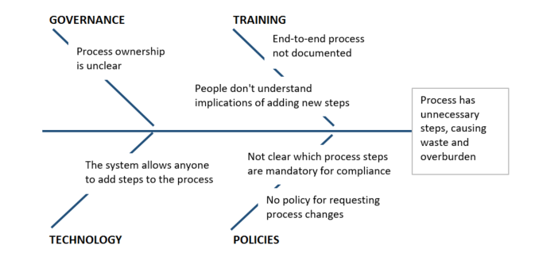
Gaps
Slide 5: What obstacles prevented you from reaching the target condition?
Describe obstacles found, explain where you discovered the gap (in Q1 or since your project began), and share your thinking that led you to understand their root causes.
Process | Current Condition What actually happened? | Target Condition What were you working towards? | Gap What got in the way of your target?
Which process step, or phase or your project was impacted due to these obstacles? [Name the process step/phase here] | * New steps added to process each month, at request of various staff and customers | * Process uses minimum number of steps required to deliver product in compliance | * Most staff only understand their own part of the process, and not the downstream impacts of adding steps
 |  | * Process review is completed before adding any new process steps | * Process steps can be added by anyone, with no review/approval process
SAMPLE
Why do these obstacles exist?
Why?
People don’t understand implications of adding new steps
Staff have not been educated on the end-to-end process
End-to-end process not documented
All the steps are not known
Have not gathered the right people to map it out
Why?
SAMPLE
Why?
SAMPLE
Why?
Why?

Slide 6
Tactics
Slide 6: Which obstacle(s) did you address?
Describe gaps you attempted to close in Q1, and the root causes you intended to eliminate by implementing your proposed countermeasure.
Process | Gap | Root Cause | Countermeasure
Which process step, or phase or your project was impacted due to these obstacles? [Name the process step/phase here] | * Most staff only understand their own part of the process, and not the downstream impacts of adding steps | * Staff are trained in their own part of the process, but not in the end-to-end process | * Hold process improvement workshop to map the end-to-end process * Include all process participants in mapping
 | * Process steps can be added by anyone, with no review/approval process | * Process ownership is not clear * Process change controls have not been documented or communicated | * Document and communicate process change controls

Slide 7
Plan-Do-Check-Adjust
Slide 7: What are you learning?
What is your next step and experiment?
Use the table below to highlight key learnings from FY-21 Q1. Describe next steps.
Plan & Do What tactics did you try? What did you hypothesize would happen? | Check (Study) How did this compare to what you expected? What did you learn from trying these tactics? | Adjust (Act) What are your next steps based on what you learned?
We held a process mapping event, including all stakeholders. We expected that seeing the end-to-end process would help everyone understand the impacts of adding steps to their part of the process. | We were able to gain a better understanding of the full process, and to identify many non-value steps to remove. We identified 2x more non-value steps than we anticipated. | We will try removing three of the non-value steps next week.
What will your approach be for Q2 and beyond? Summarize plans, opportunities and next set of milestones.
Example:
We will hold additional process mapping events for sub-processes and include all stakeholders
We will document the policy for making process changes

Slide 8
Catchball

Slide 9
-----INSTRUCTIONS: This is for your reference. Please delete this page when submitting this report-----

