Slide 1
FAS FY23 True North

Slide 2
Adapt FAS True North to Our Fast-Changing Environment
Objectives
Connect our work to mission, purpose and values
Focus on what matters most in alignment with UCSF priorities
Drive leadership discussion to:
Make visible department top priorities / projects
Be more fluid to balance urgent with longer-term goals
Identify biggest challenges / obstacles
Provide support and advice

Slide 3
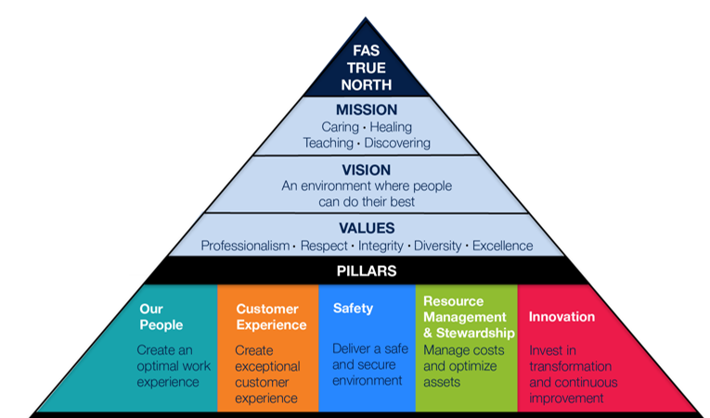

Slide 4
FY23 FAS True North Goals and Measures
Outcome Measure & Target
(where we want to end up)
Process Measure &Target
(what we’re doing during the year to make progress)
M
1
Belonging Index improves by +.02 *
M
1A
90% action plans complete and input into umbrella by 10/1/22 and at least 1 tactic complete by 3/1/23 **
M
1B
100% of FAS DEIA-AR action plans complete and submitted to SVC’s Office by 10/11/22
M
2
75% of FET areas with addressable spend opportunities have increased their spend percentage with diverse suppliers by 6/30/23
M
2A
100% of FET areas have identified opportunities and created plans by 12/31/22 to increase their % of addressable spend with diverse suppliers ***
M
3
25% of $12.8M cumulative net value target for current cohort is met by 6/30/23
M
3A
50% of projects on track to meet value creation goal at time of report-outs (3x/year); those not on track have a plan to get back on track
Notes
* Belonging Index includes 4 of the Engagement questions, plus 6 additional Belonging-specific questions
** M1A matches UCSF Health People Tactic #1
*** Diverse suppliers and addressable spend are defined by UCOP / Supply Chain Management. SCM team will work with FET areas to create plans.

Slide 5
FAS Strategic Direction Snapshot
FAS-Wide Priorities
Diversity, Equity, Inclusion, Accessibility & Anti-Racism DEIA-AR
Supplier Diversity
Value Improvement
FAS Steering Metrics

